Slide 1




Graduation
Spring 2023
Notes:
Klik met de rechtermuisknop op de foto en kies ’afbeelding wijzigen’.

Slide 2


Agenda
Objectives
Graduation
Preparation
Completion and assessment
Timeline
Q&A
Notes:
Klik per agenda item
Objective: Introduction and overview of the renewed graduation process for FHICT Bachelors​

Slide 3

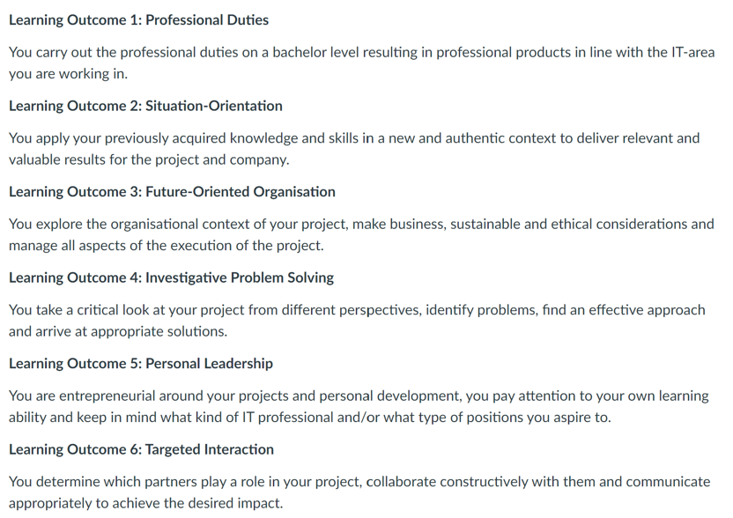
Learning Outcomes
Source: https://fhict.instructure.com/courses/12801
Notes:
https://fhict.instructure.com/courses/12801 >> PLOU: update naar productiecourse

Slide 4
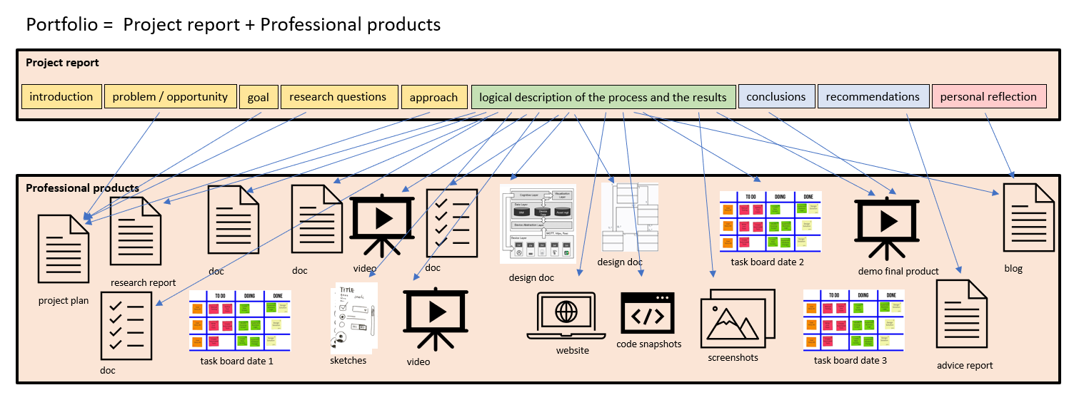
Professional products / Portfolio

Slide 5
Timeline Graduation preparation
Wk 0
Graduation “Preparation”
Wk 4-5
Kick-off Information
Main choices
Wk 17
Project Approval
Student: Acquisition assignment + project proposal
PLOU: feedback proposal + review + approval
PLOU: allocation assessors
Guidance SC current or previous semester
Policy Wiki
Notes:
https://beleidswiki.fhict.nl/doku.php?id=beleidsvoorbereiding:processen_bij_afstuderen

Slide 6

Graduation Preparation
Canvas course Internship Preparation & Job Orientation
SC guides student to get a good match between student, graduation organisation and assignment
SC of current semester or in case of external minor your last FHICT semester SC
PLOU Graduation for project approval and specific Q&A
Source: https://fhict.instructure.com/courses/10884
Notes:
https://fhict.instructure.com/courses/10884

Slide 7
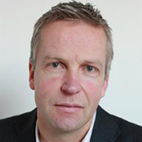


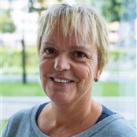



Graduation choice
Choose/adapt HBO-i architecture layer in Canvas
Define main choices:
HBO-I architecture layer (with substantion)
IT Area
Personalised Program
Language
Deadline: before Octobre 1st
HBO-I architecture layer
PLOU
Infrastructure
Michiel Koehorst
Organisational Processes
José Huisman
Hardware Interfacing
Peter Lambooij
User Interaction
Constanze Thomassen
Software
Marcel Meesters
All Layers
Herman Jurjus
(Tilburg)
Notes:
https://fhict.instructure.com/courses/12002 >> PLOU: update naar productiecourse

Slide 8
Graduation assignment
Week 17
Use ASAM or acquire assignment on your own
Criteria assignment, company, supervisor
A project in an authentic setting, with sufficient complexity
Applied Research
Level comparable to S6 or S7 Minor
HBO-i domain description proficiency level 3
Complete Project Proposal in Canvas
Feedback, update, approve by PLOU and 2nd reviewer

Slide 9
Indication of IT Areas
Smart Industry
Vision
Game play/ design
VR/AR/
XR
Embedded Systems
MES
Front-end
Design
Front-end development
Robotics
Back-end development
Web development
Fullstack development
IoT
Cyber Security
App Design
Game development
Cloud Computing
Micro services
UX Design
Block-chain
Net-working
Cloud Hosting
Test automation CI/CD
IT Operations
Low code
process Development
Colour indicates the main focus
in the HBO-i domain layer:
AI Engineering
ERP Systems
Enterprise Architecture
User Interaction
Data Analysis/ Science
Dash boarding
Organisational Processes
IT Consultancy
Infrastructure
Software
Hardware Interfacing
Source: https://beleidswiki.fhict.nl/doku.php?id=beleidsvoorbereiding:it-gebieden_voor_afstuderen
Notes:
https://beleidswiki.fhict.nl/doku.php?id=beleidsvoorbereiding:it-gebieden_voor_afstuderen

Slide 10
Complexity
Technology, innovativeness
Complexity
Innovative (Technology)
Organisational
Quality, non-functionals
Scope, quantity
Organisational
Quality
Scope

Slide 11
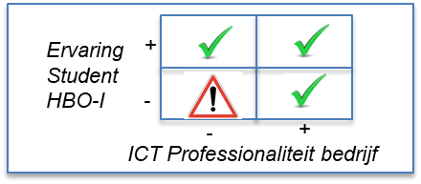
Type of Company

Slide 12
Applied Research
The “challenges”
In all phases of the project
Well structured
Methodological

Slide 13
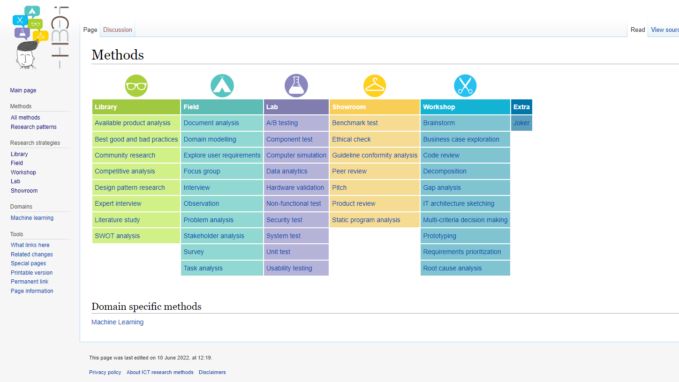
http://ictresearchmethods.nl

Slide 14
Trainee Agreement & NDA
At project start the company receives a reference to the Project Guide with Internship Conditions
Student checks if company received and accept
No other supplementary NDAs should be required by the company
If the company demands: let your graduation coordinator check
Notes:
https://lms.fhict.nl/stagegids2022/en/
https://lms.fhict.nl/stagegids2022/en/internship-conditions/

Slide 15

Portfolio
Content:
Project Report
Professional deliverables
Format matching project and IT artefact

Slide 16
Professional products / Portfolio

Slide 17
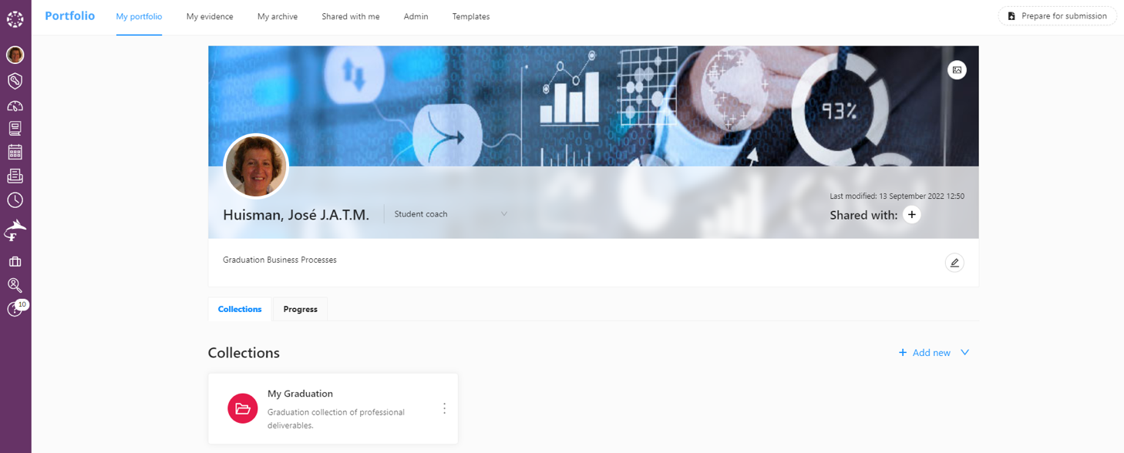
Example Digital Portfolio in Canvas
Notes:
You can use the option for a digital portfolio in Canvas (currently in pilot phase). Otherwise you can submit your portfolio as a zip file.

Slide 18
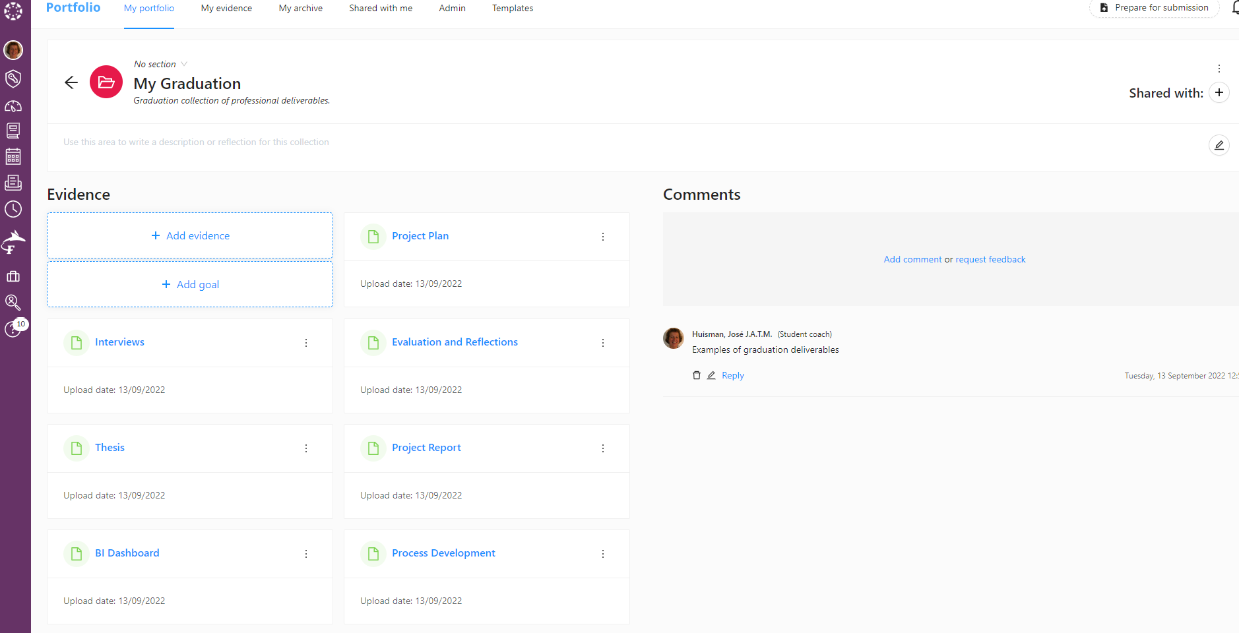

Slide 19
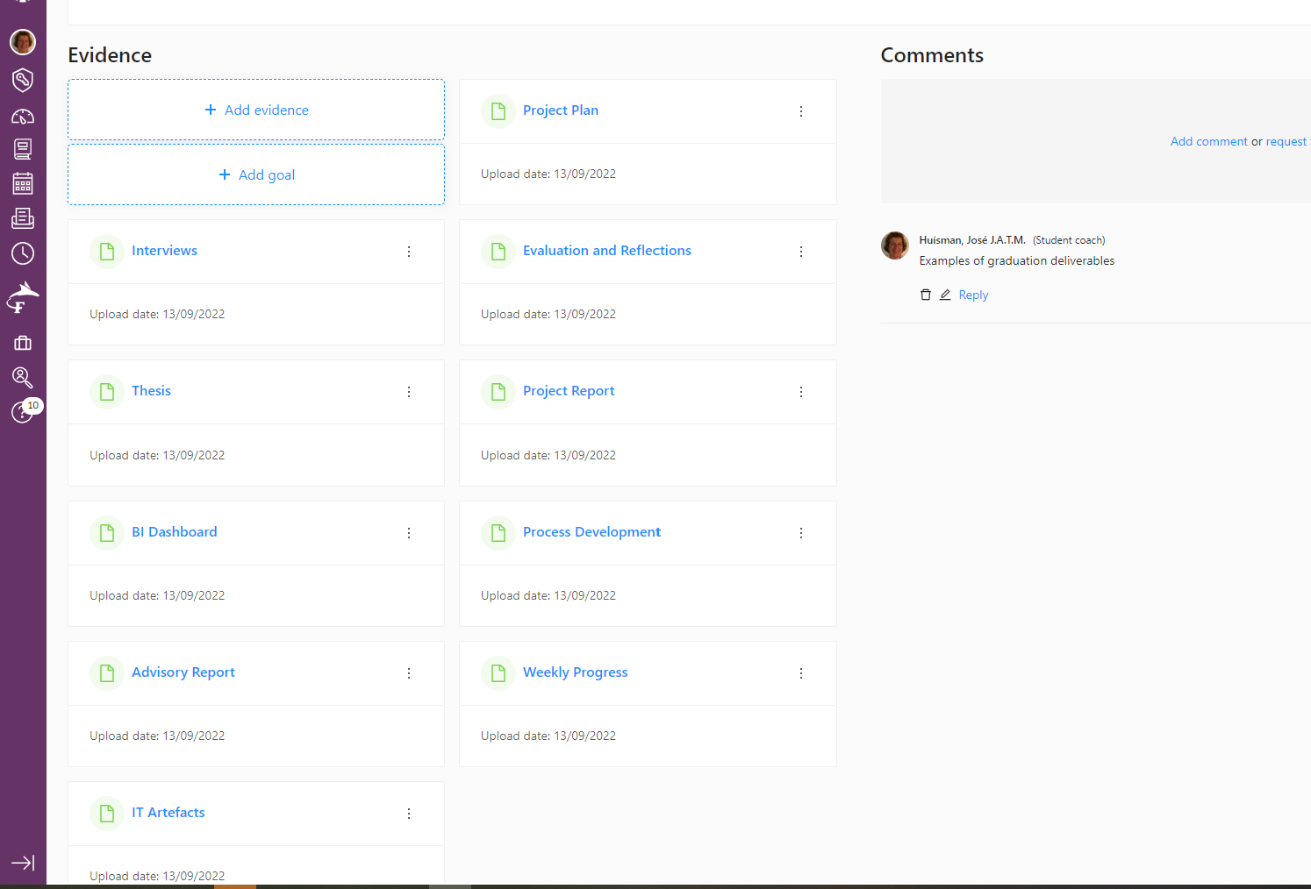

Slide 20
Assessors
Assigned before or at project start
Expertise or interest in IT areas
Language Dutch/English
Availability – priority in allocation
Notes:
IT areas: see previous slide “Indication of IT Areas”
https://beleidswiki.fhict.nl/doku.php?id=beleidsvoorbereiding:it-gebieden_voor_afstuderen

Slide 21
Indication of IT Areas
Smart Industry
Vision
Game play/ design
VR/AR/
XR
Embedded Systems
MES
Front-end
Design
Front-end development
Robotics
Back-end development
Web development
Fullstack development
IoT
Cyber Security
App Design
Game development
Cloud Computing
Micro services
UX Design
Block-chain
Net-working
Cloud Hosting
Test automation CI/CD
IT Operations
Low code
process Development
Colour indicates the main focus
in the HBO-i domain layer:
AI Engineering
ERP Systems
Enterprise Architecture
User Interaction
Data Analysis/ Science
Dash boarding
Organisational Processes
IT Consultancy
Infrastructure
Software
Hardware Interfacing
Source: https://beleidswiki.fhict.nl/doku.php?id=beleidsvoorbereiding:it-gebieden_voor_afstuderen
Notes:
https://beleidswiki.fhict.nl/doku.php?id=beleidsvoorbereiding:it-gebieden_voor_afstuderen

Slide 22
Week no Fontys | Activity | Who organises? | Who is involved?
0 | 1. Kick off | PLOU S8 | PLOU S8 and students
0-1 | 2. Meet and greet | Ass1 | Ass1 and student
1-3 | 3. Feedback project plan | Student | Ass1, Company and student
3-5 | 4. First company visit | Student | Ass1, Company and student
3-5 | 5a. Closing feedback and feedforward project plan | Ass1 | Ass1 + Ass2
3-5 | 5b. Assessors intervision (focus on project plan) | PLOU S8 | PLOU S8 and assessors
1-17 | 6a. Weekly update | Student | Ass1 and student
3-17 | 6b. Feedback deliverables | Student | Ass1 and student
7-9 | 7. Assessors intervision (focus on research, set up Project Report, progress, check analysis results previous semester) | PLOU S8 | PLOU S8 and assessors
10 | 8. Information and Q&A on continuation graduation internship | PLOU S8 | PLOU S8 and students
10 | 9a. Midterm Review | Ass1 | Ass1+Company+Ass2+student
10 | 9b. Plan Graduation Expo | PLOU S8 | PLOU S8 and UM
10-15 | 10a. Feedback draft Project Report | Student | Ass1 and student
15-16 | 10b. Feedback final Project Report | Student | Ass1 and student
15-16 | 11. Assessors intervision (focus on Project Report) | PLOU S8 | PLOU S8 and assessors
17-18 | 12. Second company visit | Student | Ass1, Company and student
17-19 | 13a. Preliminary discussion final assessment | Ass1 | Ass1 + Ass2
 | 13b. Calibration preliminary final assessments (with 4-6 assessoren) | One of the assesors | Assessors involved
18-19 | 14. Graduation Expo | UM (040 + 013) | PLOU S8, assessors, students, external expert, Company
19+20 | 15. Assessment | Student Desk | Ass1 + Ass2 + external expert + student
Processes
Notes:
https://beleidswiki.fhict.nl/doku.php?id=beleidsvoorbereiding:processen_bij_afstuderen

Slide 23
Timeline
Wk 0
Kick-off
Wk 0-1
Meet & Greet
Wk 3-5
Company Visit + Assessors Intervision
Wk 10
Midterm Review
Wk 17
Project Report
Feedback Project Plan
Wk 19
Grad. Expo
Weekly update in FeedPulse + feedback deliverables
Wk 19-20
Assessment
feedback portfolio – draft | final
Project Plan
Research
Professional products
Portfolio
Assessment
Assessors Calibration
Policy Wiki
Notes:
https://beleidswiki.fhict.nl/doku.php?id=beleidsvoorbereiding:processen_bij_afstuderen

Slide 24




Midterm Review
Week 10
Company Coach
Development oriented feedback
Student
Student self assessment
Canvas
Assessors
Midterm Review feedback + Format end presentation
Weekly blog
Student
Notes:
Objective Midterm Review is Evaluation
The company coach provides development oriented feedback
The student performs a self assessment
Both assessors share their findings based on this input and their own observations with the student in Canvas also. They explain this review and feedback in a Midterm Review meeting.
Assessors together determine the presentation format (demo, keynote, lightning talk, poster, ...) of the student’s presentation on the Graduation Expo and communicate this to the PLOU S8.
Weekly update and feedback will be processed in Feedpulse!

Slide 25
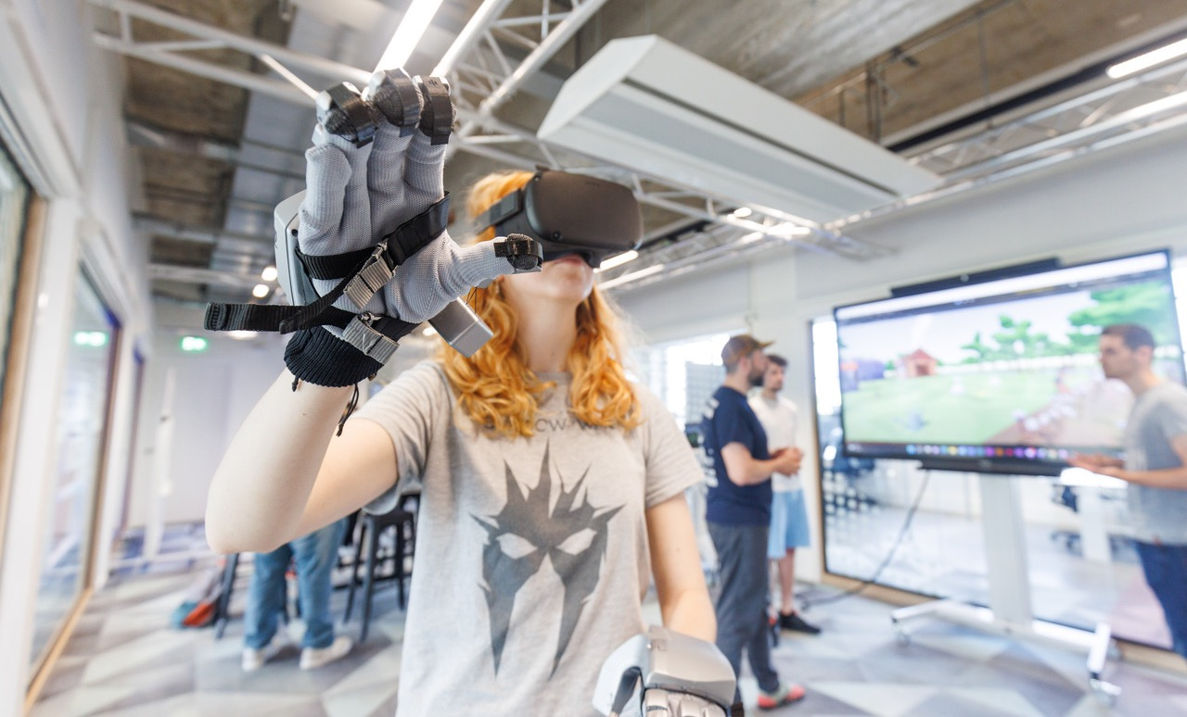
Setup Graduation Expo
Week 19
Audience consist of interested stakeholders, external field, current and potential students, teacher and researchers from FHICT and from outside
Presentation formats can be a key-note, a presentation or a poster presentation, demonstration with explanation of the final product, flashlight
The Expo is set up on 2-4 days, thematically according to the HBO-i architecture layers
Source: https://beleidswiki.fhict.nl/doku.php?id=en:beleid:beoordeling_afstudeerstage_bachelor&s[]=%2Agraduation%2A&s[]=%2Aexpo%2A
Notes:
https://beleidswiki.fhict.nl/doku.php?id=en:beleid:beoordeling_afstudeerstage_bachelor&s[]=%2Agraduation%2A&s[]=%2Aexpo%2A

Slide 26
Graduation Expo
Week 19
Presentation
Format
Q&A
Sharing knowledge
Graduation Project
Project nature, innovativeness
Expected interest
Assessors and external expert
Audience
Student shows evidence and performance
Early year students
Student’s preference
Interested parties
Student
Assessors
Assessors and external expert
Audience
Source: https://beleidswiki.fhict.nl/doku.php?id=en:beleid:beoordeling_afstudeerstage_bachelor&s[]=%2Agraduation%2A&s[]=%2Aexpo%2A
Notes:
Candidate presents his graduation project on the Graduation Expo.
Presentation format is determined by the assessors, depending on the project’s nature, innovativeness, student preference and expected interest in the subject.
The presentation is followed by questions from the assessors, the external expert and the audience. In his responding the graduate shows evidence and performance.
Thus, knowledge is shared and early years students get an impression of graduation level and opportunities.
Only students with bad perspective, can withdraw from this event. Consequently, this leads to an Unsufficient mark and restart.
Setup Graduation Expo
Audience consist of interested stakeholders, external field, current and potential students, teachers and researchers from FHICT and from outside and close relatives.
Presentation can be keynote, presentation or poster presentation, demonstration with explanation of the final product, flashlight etc.
Expo set up is on 2-3 days, thematically according to the HBO-i architecture layers.

Slide 27
Assessment
Week 19 - 20
Project Report
Graduation Expo
Assessment
Notes:
https://beleidswiki.fhict.nl/doku.php?id=en:beleid:beoordeling_afstudeerstage_bachelor&s[]=%2Agraduation%2A&s[]=%2Aexpo%2A
Assessors collect all input from Canvas and Graduation Expo.
Student has an opportunity to clarify any last questions and uncertainties to the 1st and 2nd assessor and external expert.
Afterwards, the two assessors determine the final mark, with the external expert in an advisory role. Final mark is explained and motivated per dimension in the assessment form.
In case of an “Unsatisfactory”, the assessors determine the form and duration of the new graduation assignment. This can be a complete restart, or a more limited assignment with which the student can demonstrate the identified deficiencies.
Tekst mag ingedikt.

Slide 28
Assessment
Week 19 - 20
A few days after the Graduation Expo, duration max 30 minutes.
Assessors collect all input from Canvas and Graduation Expo.
Student has an opportunity to clarify any last questions and uncertainties to the 1st and 2nd assessor and external expert.
Afterwards, the two assessors determine the final mark, with the external expert in an advisory role. Final mark is explained and motivated per dimension in the assessment form.
In case of an “Unsatisfactory”, the assessors determine the form and duration of the new graduation assignment. This can be a complete restart, or a more limited assignment with which the student can demonstrate the identified deficiencies.
Notes:
https://beleidswiki.fhict.nl/doku.php?id=en:beleid:beoordeling_afstudeerstage_bachelor&s[]=%2Agraduation%2A&s[]=%2Aexpo%2A
Tekst mag ingedikt.

Slide 29
Roles and responsibilities
Internship Coordinator / PLOU
Company supervisor
FHICT supervisor (1st assessor)
Assessment chair (2nd assessor)
External Expert (part of jury)
Student Desk (studentdeskfhict-teamB@fontys.nl)
Exam Board

Slide 30
Deadlines
Deadline project proposal:
Main choices: ( < Fontys week 7)
Project Proposal: Tuesday January 10th, 2023 (Fontys week 17)
Other important dates
Start internship: Monday February 6th, 2023 (Fontys week 1).
Deadline submission internship report/portfolio: Tuesday June 13th, 2023 at 14.00 hours (Fontys week 17)
End of internship: After Assessment
Graduation Expo: Tuesday June 27th to Thursday 29 (Fontys week 19)
Assessment: Period from Friday June 30th, 2023 to Friday July 7th, 2023 (Fontys week 19+20)

Slide 31
Further info
Canvas course Graduation
If you start in Spring 2022-2023 you will get course soon
Start later: See A-Graduation-PCI Canvas course
Graduation assignments: FHICT ASAM systeem
Company flyer (also accesible to external companies)
If companies want to submit an assignment:
https://praktijkopdrachten.fhict.nl
If you need extra help (e.g. writing, communication)
Contact Student +
If you want to graduate abroad:
www.studyabroadfontysict.nl

Slide 32

FHICT Career Day on 8/11 Tilburg & 10/11 Eindhoven
www.partnersfontysict.nl

Slide 33
Q&A
PLOU Software: Marcel Meesters, marcel.meesters@fontys.nl

